Slide 1

DATA SCIENCE
Market Basket Analysis
Association Rules

Slide 2
Market Basket Analysis
Can we really get insight from market baskets?

Slide 3
Market Basket Analysis
Provides insight into which products tend to be purchased together and which are most amenable to promotion.
Can return
Actionable rules
Trivial rules
-People who buy shoes also buy socks
Inexplicable
-People who buy shirts also buy milk

Slide 4
Market Basket Analysis
Cross Selling
Offer an associated item when the customer buys any product
Product Placement
Customer Behaviour
Based on Credit Card usage data, we may be able to detect certain purchase behaviour that can be associated with fraud
Fraud Detection
Pharma
Medical patient histories can give indications of likely complications based on certain combinations of treatments

Slide 5
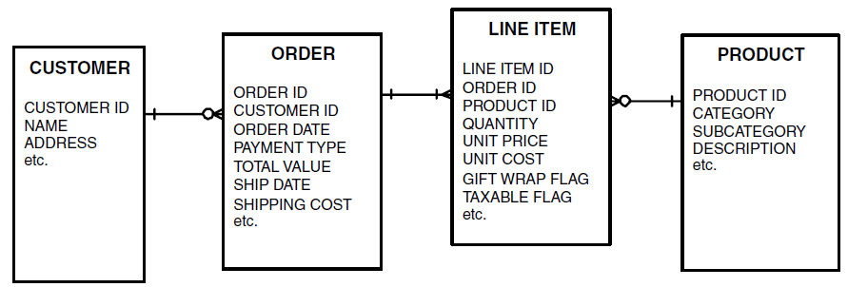
Database Structure

Slide 6
Frequent Market Basket Questions
What is the average number of orders per customer?
What is the most common item found in a one-item order?
What is the average number of unique items per order?
What is the average number of items per order?

Slide 7
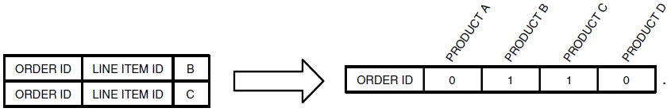
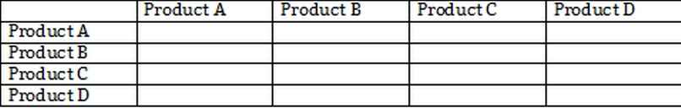
Transform the Data and form a Co-Occurrence Table

Slide 8
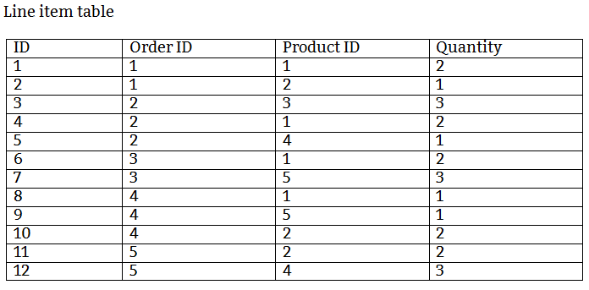
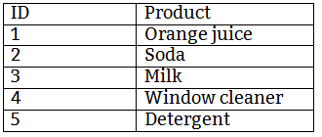
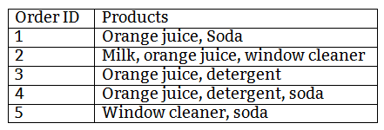
Use Case

Slide 9
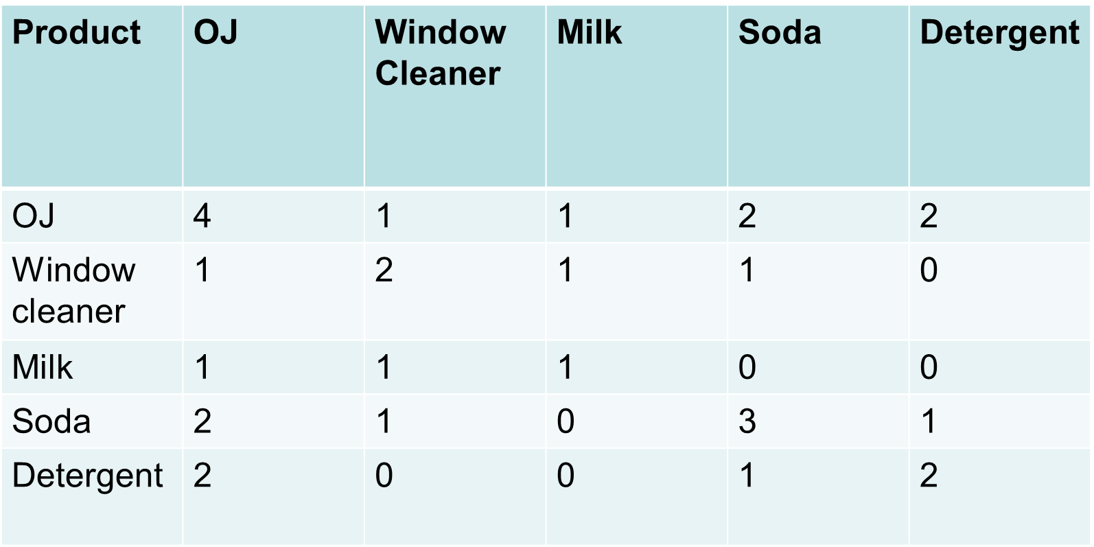
Find the Insights??

Slide 10
How do we generate these rules automatically on large data?

Slide 11
Apriori Algorithm
- FP Tree

Slide 12
Apriori Algorithm
Database D
Minsup = 0.5
L₁
C₁
Scan D
C₂
C₂
L₂
Scan D
C₃
L₃

Slide 13
Apriori Algorithm
Apriori can be very slow as it needs to compute the support at every instance by looking at the original itemset
We need a quicker implementation
FP Tree

Slide 14
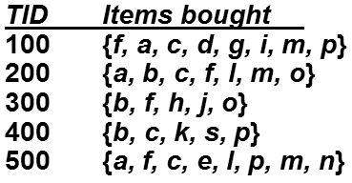
Example – FP TREE

Slide 15
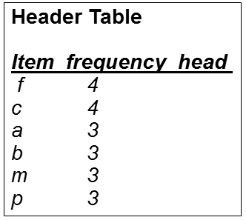
Example – FP TREE
We avoided all those items that do not have the minimum support of 50% (so, a count of 3 in 5 transactions). So, d, e, g, h, I, j, k, l and n are dropped as their count is lower than 2.

Slide 16
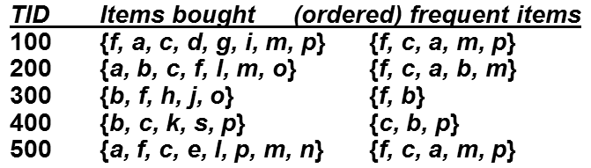
Re-Order the Item Sets

Slide 17
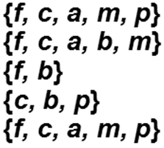
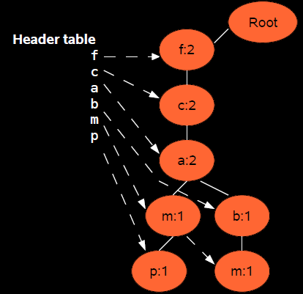
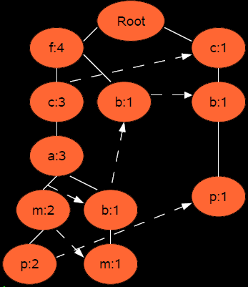
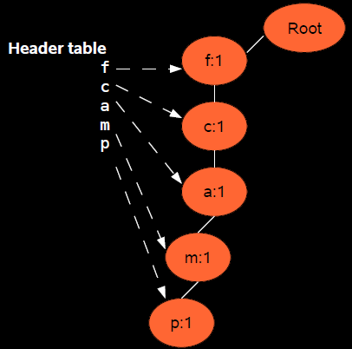
FP TREE

Slide 18
FP TREE
It never breaks a long pattern of any transaction
reduces irrelevant information—infrequent items are gone
More frequent items are more likely to be shared and are at the top
We keep a count at the nodes to compute support/confidence. So, no need to view the DB again.

Slide 19


Slide 20

Let’s

